Slide 1
Chapter 6
Multiple Regression Analysis: Further Issues

Slide 2
Multiple Regression Analysis: Further Issues (1 of 16)
More on Functional Form
More on using logarithmic functional forms:
Convenient percentage/elasticity interpretation
Slope coefficients of logged variables are invariant to rescalings
Taking logs often eliminates/mitigates problems with outliers
Taking logs often helps to secure normality and homoskedasticity
Variables measured in units such as years should not be logged
Variables measured in percentage points should also not be logged
Logs must not be used if variables take on zero or negative values
It is hard to reverse the log-operation when constructing predictions

Slide 3
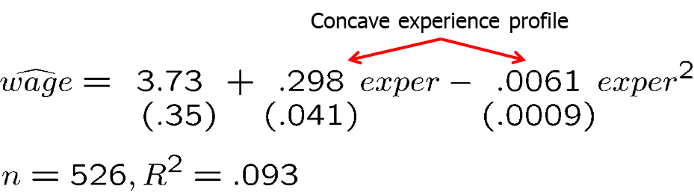
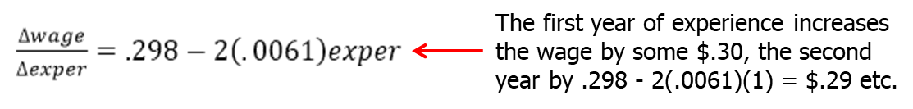
Multiple Regression Analysis: Further Issues (2 of 16)
Using quadratic functional forms
Example: Wage equation
Marginal effect of experience

Slide 4
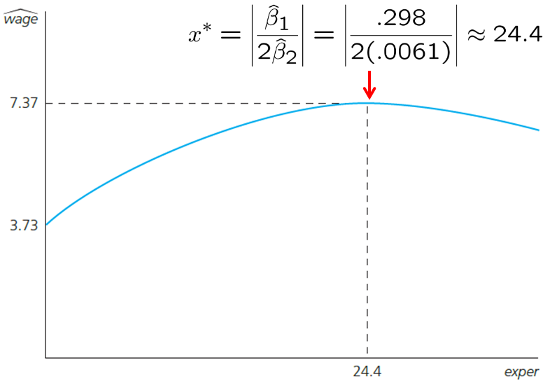
Multiple Regression Analysis: Further Issues (3 of 16)
Wage maximum with respect to work experience
Does this mean the return to experience becomes negative after 24.4 years?
Not necessarily. It depends on how many observations in the sample lie to the right of the turnaround point.
In the given example, these are about 28% of the observations. There may be a specification problem (e.g. omitted variables).

Slide 5
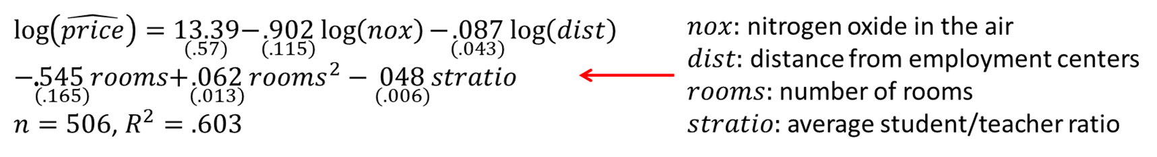
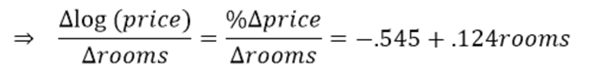
Multiple Regression Analysis: Further Issues (4 of 16)
Example: Effects of pollution on housing prices
Does this mean that, at a low number of rooms, more rooms are associated with lower prices?

Slide 6
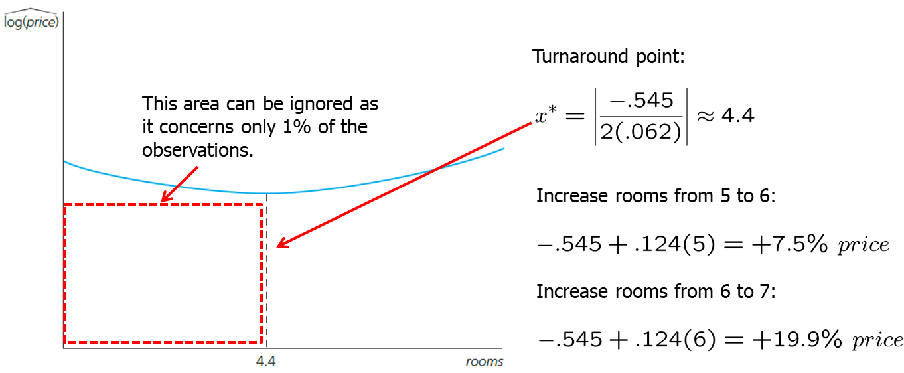
Multiple Regression Analysis: Further Issues (5 of 16)
Calculation of the turnaround point

Slide 7
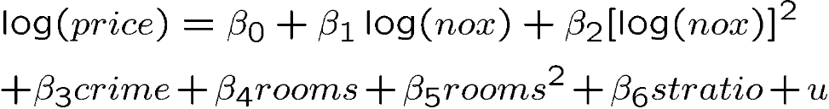
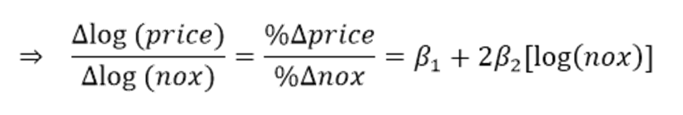
Multiple Regression Analysis: Further Issues (6 of 16)
Other possibilities
Higher polynomials

Slide 8
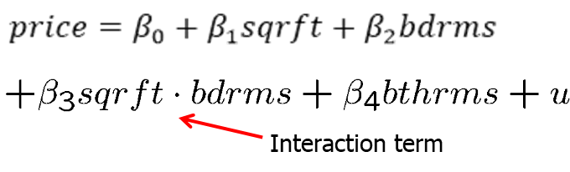
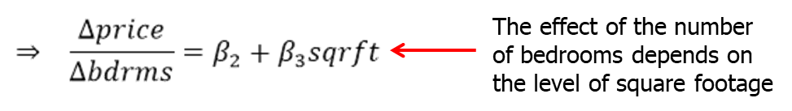
Multiple Regression Analysis: Further Issues (7 of 16)
Models with interaction terms
Interaction effects complicate interpretation of parameters

Slide 9
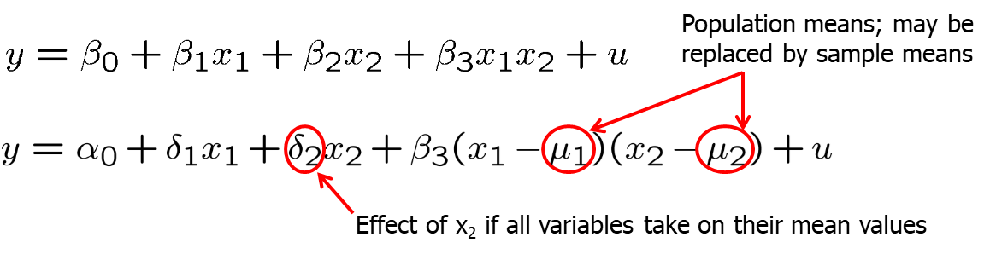
Multiple Regression Analysis: Further Issues (8 of 16)
Reparametrization of interaction effects
Advantages of reparametrization
Easy interpretation of all parameters
Standard errors for partial effects at the mean values available
If necessary, interaction may be centered at other interesting values

Slide 10
Multiple Regression Analysis: Further Issues (9 of 16)
Average partial effects
In models with quadratics, interactions, and other nonlinear functional forms, the partial effect depend on the values of one or more explanatory variables
Average partial effect (APE) is a summary measure to describe the relationship between dependent variable and each explanatory variable
After computing the partial effect and plugging in the estimated parameters, average the partial effects for each unit across the sample

Slide 11
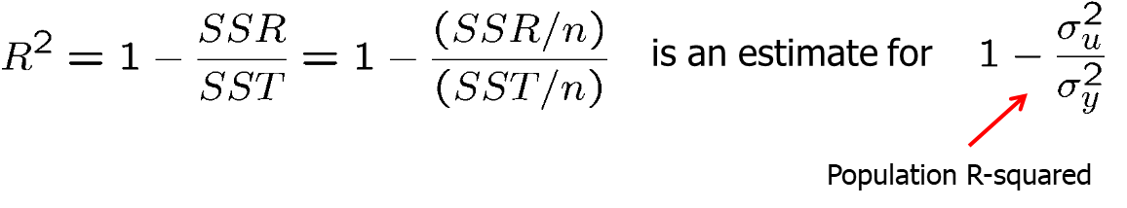
Multiple Regression Analysis: Further Issues (10 of 16)
More on goodness-of-fit and selection of regressors
General remarks on R-squared
A high R-squared does not imply that there is a causal interpretation
A low R-squared does not preclude precise estimation of partial effects
Adjusted R-squared
What is the ordinary R-squared supposed to measure?

Slide 12
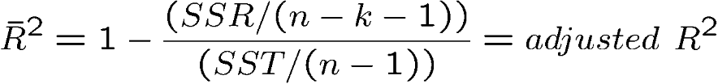
Multiple Regression Analysis: Further Issues (11 of 16)
Adjusted R-squared (cont.)
A better estimate taking into account degrees of freedom would be
The adjusted R-squared imposes a penalty for adding new regressors
The adjusted R-squared increases if, and only if, the t-statistic of a newly added regressor is greater than one in absolute value
Relationship between R-squared and adjusted R-squared

Slide 13
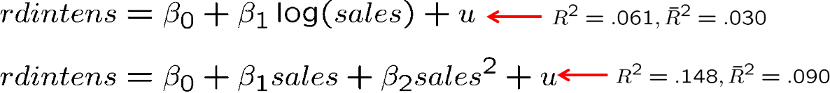
Multiple Regression Analysis: Further Issues (12 of 16)
Using adjusted R-squared to choose between nonnested models
Models are nonnested if neither model is a special case of the other
A comparison between the R-squared of both models would be unfair to the first model because the first model contains fewer parameters
In the given example, even after adjusting for the difference in degrees of freedom, the quadratic model is preferred

Slide 14
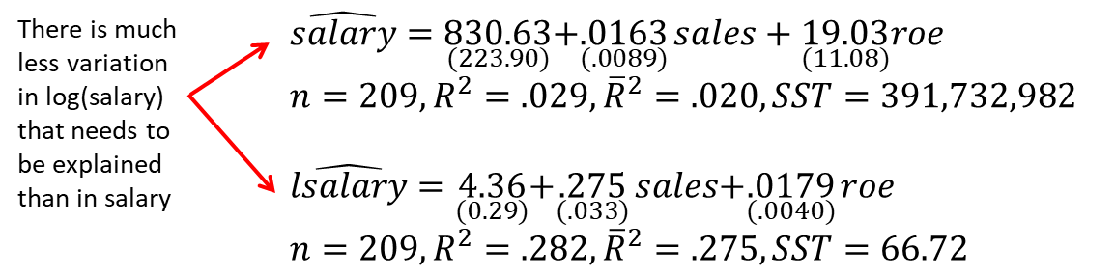
Multiple Regression Analysis: Further Issues (13 of 16)
Comparing models with different dependent variables
R-squared or adjusted R-squared must not be used to compare models which differ in their definition of the dependent variable
Example: CEO compensation and firm performance

Slide 15
Multiple Regression Analysis: Further Issues (14 of 16)
Controlling for too many factors in regression analysis
In some cases, certain variables should not be held fixed
In a regression of traffic fatalities on state beer taxes (and other factors) one should not directly control for beer consumption
In a regression of family health expenditures on pesticide usage among farmers one should not control for doctor visits
Different regressions may serve different purposes
In a regression of house prices on house characteristics, one would only include price assessments if the purpose of the regression is to study their validity; otherwise one would not include them

Slide 16
Multiple Regression Analysis: Further Issues (15 of 16)
Adding regressors to reduce the error variance
Adding regressors may excarcerbate multicollinearity problems
On the other hand, adding regressors reduces the error variance
Variables that are uncorrelated with other regressors should be added because they reduce error variance without increasing multicollinearity
However, such uncorrelated variables may be hard to find
Example: Individual beer consumption and beer prices
Including individual characteristics in a regression of beer consumption on beer prices leads to more precise estimates of the price elasticity

Slide 17
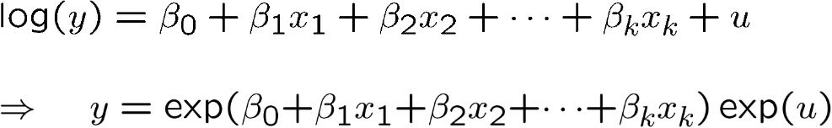
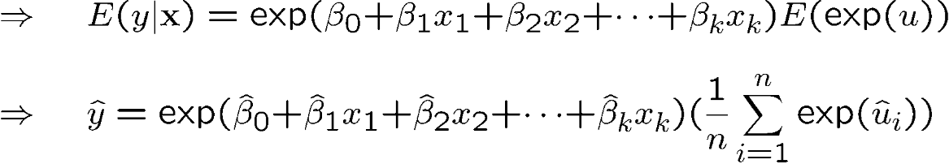
Multiple Regression Analysis: Further Issues (16 of 16)
Predicting y when log(y) is the dependent variable
Under the additional assumption that u is independent of x₁,...,x_{k}:

